Slide 1


Fundamentals of RM
RM System and Process
Leadership in RM
Incident Investigation
RM Tools & Challenges
RM in Industry
People & Org.
Application and Perspectives
On Becoming a
Leader in Risk Management
ENGG404 - Lecture
Chapter 5.2:
The Fundamental Approach to
Control All Risks
(Hierarchy of Effectiveness)

Slide 2
Learning Outcomes:
Explain two different approaches for a Risk Reduction Hierarchy:
AB OH&S Code Part 2 Hazard Assessment, Elimination, and Control
ANSI Z10-2012: Risk Reduction Hierarchy & Hierarchy of Effectiveness
Apply the two different approaches to identify, evaluate, and select the most effective risk reduction solution(s).
Explain that order of effectiveness is NOT an order of priority.
Chapter 5.2: Fundamental Approach to Control All Risks
2
Notes:
2
APEGA’ minimum requirements

Slide 3
Risk Reduction Hierarchy & Hierarchy of Effectiveness
You want to implement the most effective risk reduction solutions i.e. the safeguards or control measures in the form of engineering controls & administrative controls.
How do you identify, evaluate, and select the most effective risk reduction solutions i.e. the most effective safeguard / control measure?
The fundamental approach to control all risks is simply a hierarchy.
Two approaches (of many) are:
AB OH&S Code Part 2 Hazard Assessment, Elimination, and Control
ANSI Z10-2012: Risk Reduction Hierarchy & Hierarchy of Effectiveness
Chapter 5.2: Fundamental Approach to Control All Risks
3
Notes:
3
APEGA’ minimum requirements

Slide 4
AB OH&S Code Part 2:
AB OH&S Code Part 2 Hazard Assessment, Elimination, and Control
The AB OH&S Code Part 2 Section 9 specifies the order of effectiveness, a basic approach of a Risk Reduction Hierarchy:
  Eliminate
  Apply Engineering Controls to Reduce the Exposure
  Apply Administrative Controls and Work Practices
  to Reduce the Exposure
  Use PPE
  Use combinations of above.
Most facilities usually apply and “prioritize” PPE first” because it is easy even though it is the least effective!
Chapter 5.2: Fundamental Approach to Control All Risks
4
Notes:
4
APEGA’ minimum requirements

Slide 5
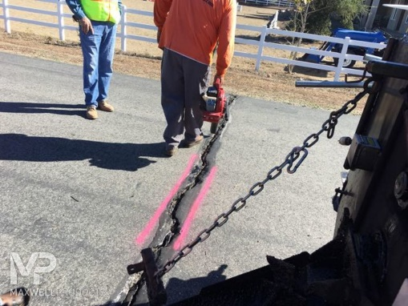
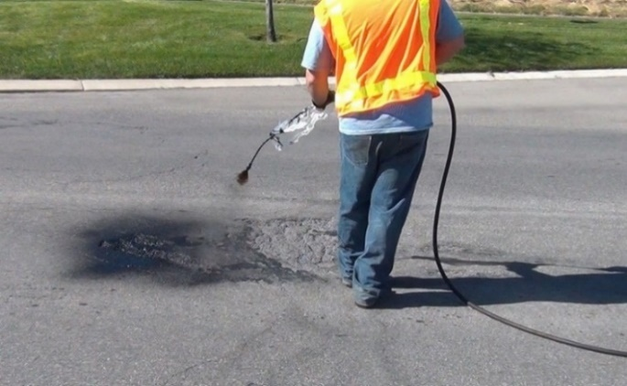
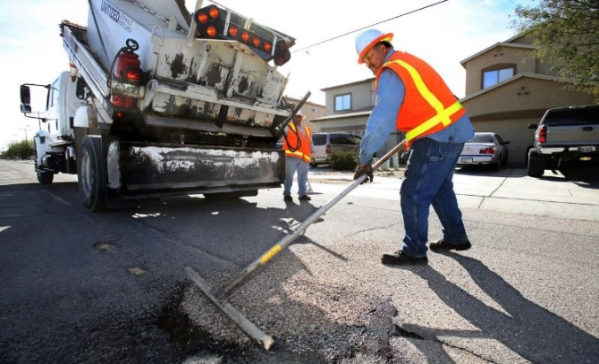
ALE #1: Apply AB OH&S Code Part 2 to Spray-Patch Crew
Please confer and respond (Open discussion):
Consider this job (activity) and its hazards:
Job: typical spray-patch crew:
crack is gouged,
sprayed with hot tar-oil,
filled and tamped with pea gravel.
Hazards to address:
exposure to traffic,
crushed by moving dump truck,
repetitive shoveling / spraying motions,
contact with hot tar.
Choose 1 hazard and apply
the AB OH&S Code Part 2.
Eliminate
Apply Engineering Controls to Reduce the Exposure
Apply Administrative Controls and Work Practices
to Reduce the Exposure
Use PPE
Use combinations of above.
Chapter 5.2: Fundamental Approach to Control All Risks
5
Notes:
5
APEGA’ minimum requirements

Slide 6
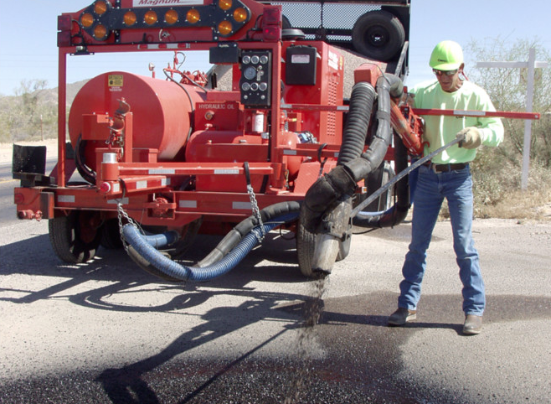
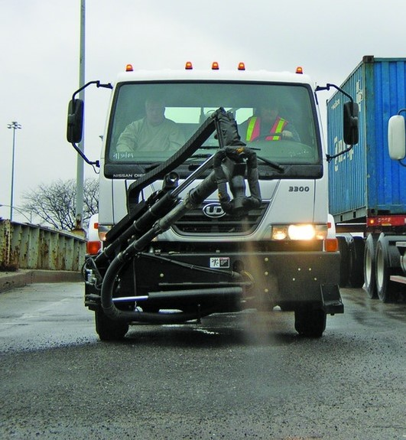
Example: Apply AB OH&S Code Part 2 to Spray-Patch Crew
Eliminates:
crushed by moving dump truck,
repetitive shoveling motion,
contact with hot tar.
Eliminates:
crushed by moving dump truck,
all repetitive motions,
contact with hot tar AND
exposure to traffic.
Chapter 5.2: Fundamental Approach to Control All Risks
6
Notes:
6
APEGA’ minimum requirements

Slide 7
ANSI Z10-2012: Risk Reduction Hierarchy & Hierarchy of Effectiveness
ANSI Z10-2012 has same order as AB OH&S but includes “substitution”.
Chapter 5.2: Fundamental Approach to Control All Risks
7
Notes:
7
Order of effectiveness, not priority!!! Maybe you prioritize using PPE in a lab because it’s easy, but not the most effective way of reducing risk.
Apply engineering controls – encompasses substitute, isolate/separate, engineer
Apply admin controls – organization and procedures (there’s a policy for when you wear ppe)
PPE – work practices (I am wearing my ppe)
They work together

Slide 8
ANSI Z10-2012: Risk Reduction Hierarchy & Hierarchy of Effectiveness
Chapter 5.2: Fundamental Approach to Control All Risks
8
Notes:
8

Slide 9
Examples of Application of ANSI Z10-21012:
Hierarchy Level | Example
Eliminate | Evacuate the piping system of the hazard. Fill in the hole to eliminate a fall hazard.
Substitute | A non-toxic substance instead of a toxic substance
Isolate / Separate | A work platform instead of using personal fall arrest. Closed-loop sampling system.
Engineering Controls | Noise-dampening technology to reduce noise levels. Mechanical-assist lifting devices instead of physical effort. Exhaust ventilation system to draw away contaminated air e.g. fume hood or welding hood.
Warnings / Organization | Train workers to observe warning signs, labels, alarms, and how to respond Additional workers for relief and rotation in hazardous conditions e.g. hot weather / hot environments.
Administrative Controls | Policies / procedures (PTWs, checklists, JSAs, FLRAs, SQRAs, etc.) that describe how to do the safe execution of work e.g. walk on designated in-plant walkways
PPE | Flame retardant clothing, hard hats, eye protection, respiratory protection, face protection, gloves, safety boots, flash suit
Chapter 5.2: Fundamental Approach to Control All Risks
9
Notes:
9
Potentially tie in Fernie example with regard to engineering controls (substitute, isolate, engineer)
-replace the brine with ethylene glycol (antifreeze) – substitute, or replace the ammonia with freeon - substitute
-use a more corrosion resistant heat exchanger (shellen tube?) -

Slide 10
ALE #2: Apply ANSI Z10 to Fernie Arena Refrigeration System
Please confer (Open discussion):
How would you apply the ANSI Z10-2012 hierarchy
of controls to the refrigeration system hazards at the
Fernie Arena? Identify 1 or 2 examples.
Hierarchy Level | Example
Eliminate
Substitute | Freon-type refrigerant instead of ammonia
Isolate / Separate
Engineering Controls
Warnings / Organization
Administrative Controls
PPE | self-contained breathing air
Chapter 5.2: Fundamental Approach to Control All Risks
10
Notes:
10
Potentially tie in Fernie example with regard to engineering controls (substitute, isolate, engineer)
-replace the brine with ethylene glycol (antifreeze) – substitute, or replace the ammonia with freon - substitute
-use a more corrosion resistant heat exchanger (higher alloys)

Slide 11
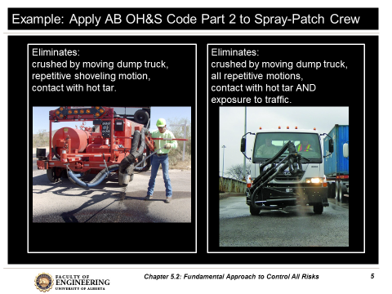
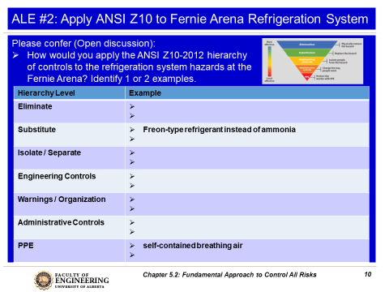
Intent of These Active Learning Exercises:
Apply AB OH&S Code Part 2 to Spray-Patch Crew
Apply ANSI Z10 to Fernie Arena Refrigeration System
The intent is to give you an opportunity to practice these approaches, and NOT to instruct you on specific solutions to these problems.
Chapter 5.2: Fundamental Approach to Control All Risks
11
Notes:
11
APEGA’ minimum requirements

Slide 12
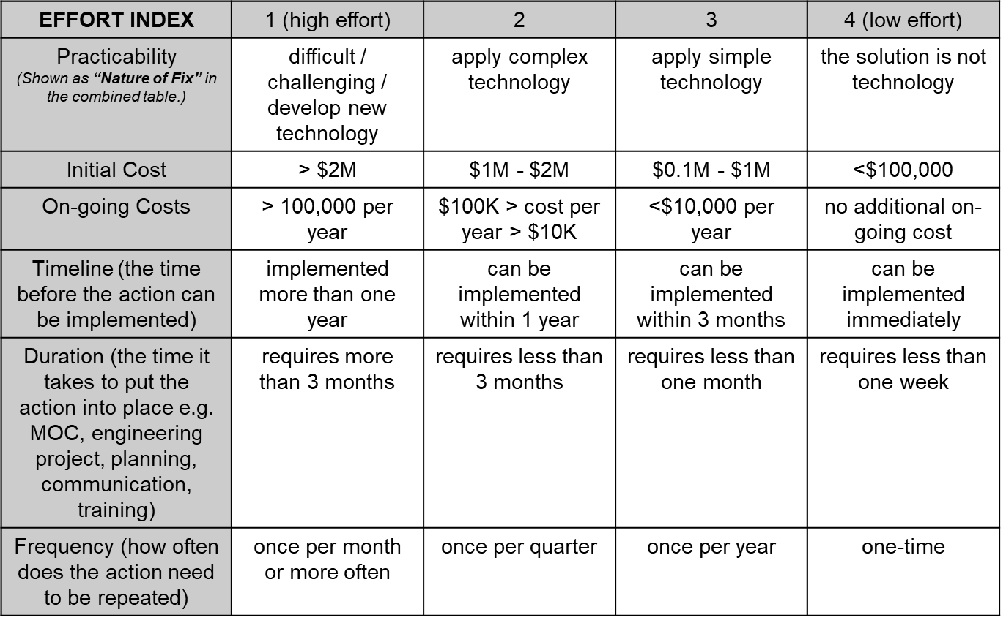
Key Difference Between Hierarchy of Effectiveness & Order of Priority:
This tool is a hierarchy of effectiveness and yields an order of effectiveness,
NOT an order of priority.
In a future seminar, the Complex Effort vs Gain Tool will be presented; this tool helps us to prioritize the implementation
of recommendations.
Chapter 5.2: Fundamental Approach to Control All Risks
12
Notes:
12
I.e. PPE – you prioritize it because it’s easy and cheap, but it is not the most effective risk reduction solution!

Slide 13
Any questions?
Notes:
13

